Slide 1
Questionable File
Show and Tell
Much thanks to contributors
Anonymous, Eddy Colloton, Rebecca Fraimow, Shu-Wen Lin,
Rebecca Fraimow, Blake McDowell, Crystal Sanchez Annie Schweikert
Julia Kim @jy_kim29
American Folklife Center | NTTW #4 2019

Slide 2
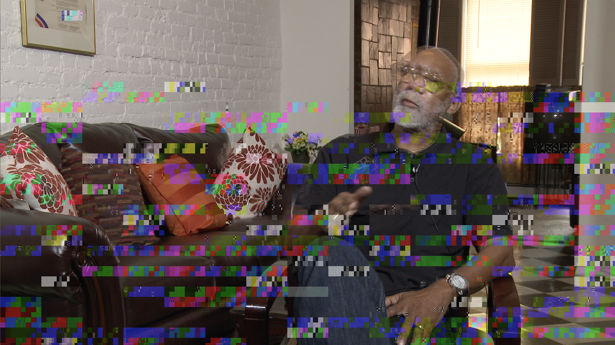

Slide 3
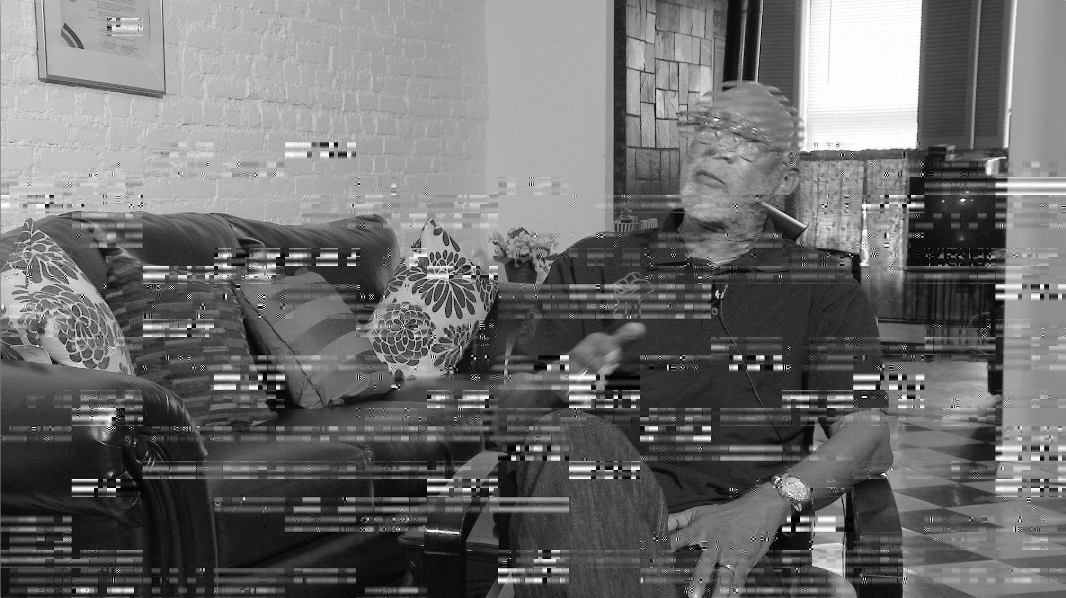
The Checksums verified but ... ….
Born-digital capture
Checksums matched, but were created upon receipt at the archive.
Failures detected at multiple levels -
at Ingest
When transcoding
Different levels of failure - from playable but corrupt frames to totally unplayable broken files missing header metadata (“moov atom not found”)
Issue affected 3 interviews, approximately 20 files
Thanks also to Crystal Sanchez @cristalyze, Smithsonian
Blake McDowell, National Museum of African American History and Culture, Smithsonian

Slide 4
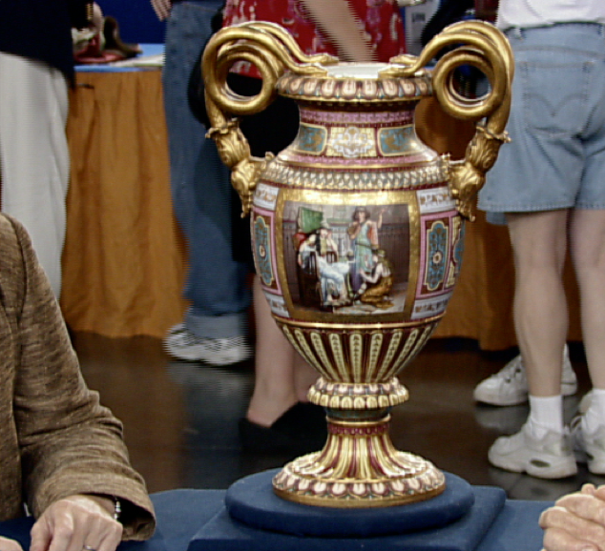

Slide 5
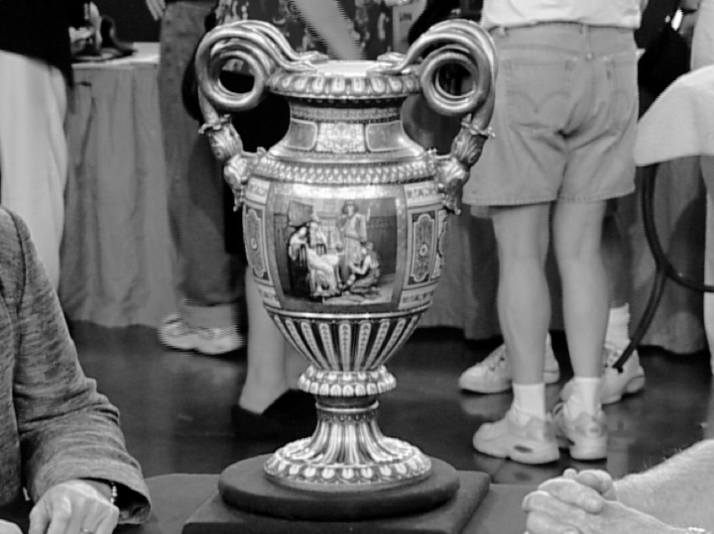
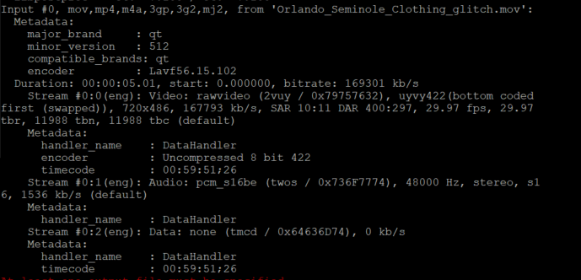
2. Static image for the expected duration
Born-digital migrated files
- static “frame” but expected
duration and file size.
Caught during a manual QC.
Necessitated modifying QC protocols
to create gallery thumbnails
to catch other files with this problem.
Otherwise passed automated QC,
no other discrepancies found
Hundreds? of files found with this
specific issue.
Thanks to Rebecca Fraimow @rhfraim
WGBH

Slide 6
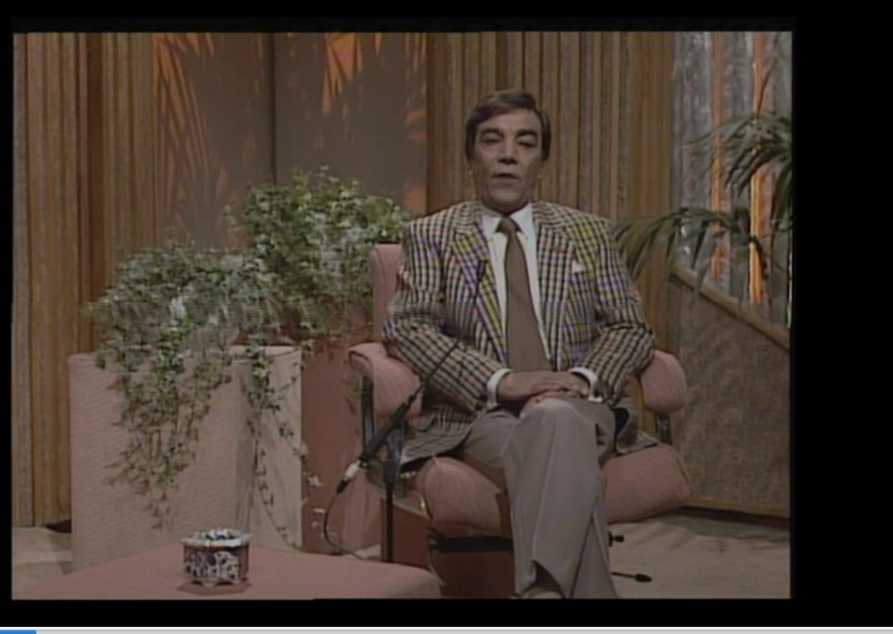

Slide 7
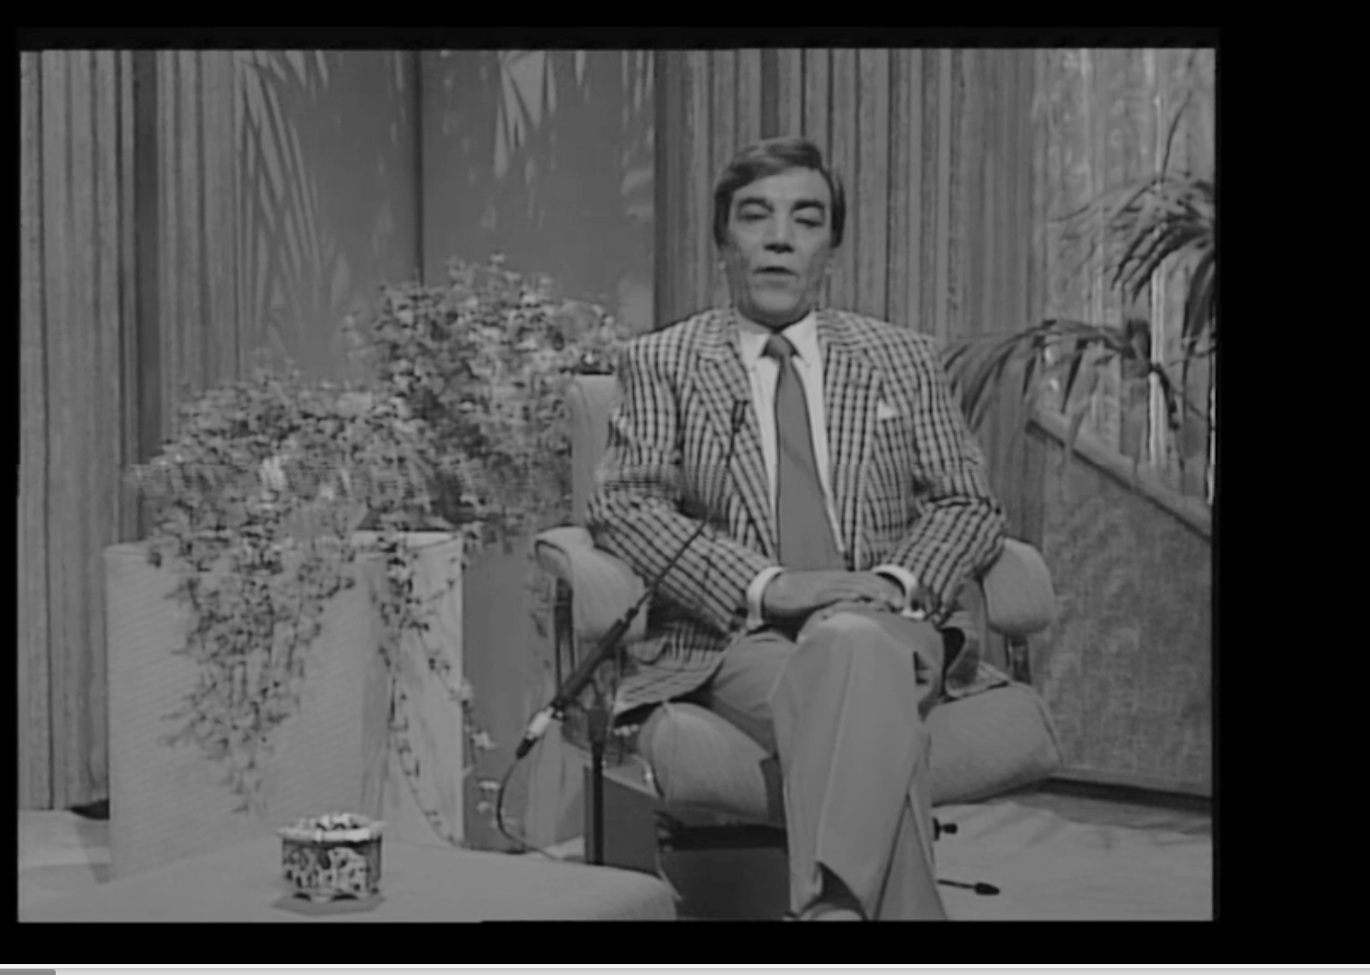
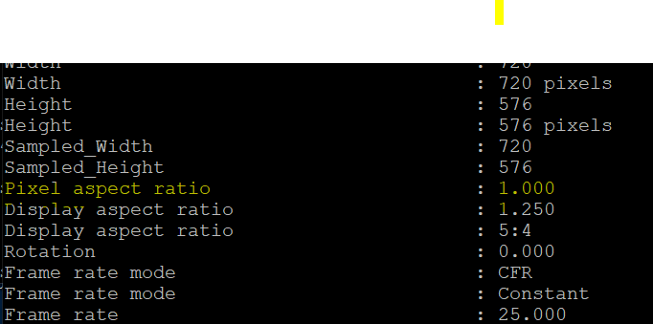
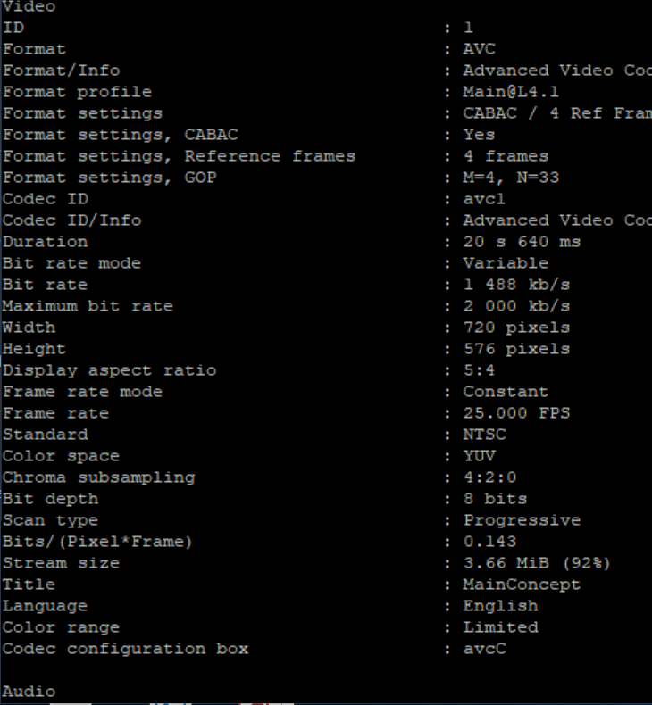
3. PAL AND NTSC
Digitized
Failed visual QC -
Horizontal “disruption”
Both Standards:
Made for PAL broadcast,
But Mediainfo also finds
NTSC Standard
Much thanks to Anonymous!

Slide 10
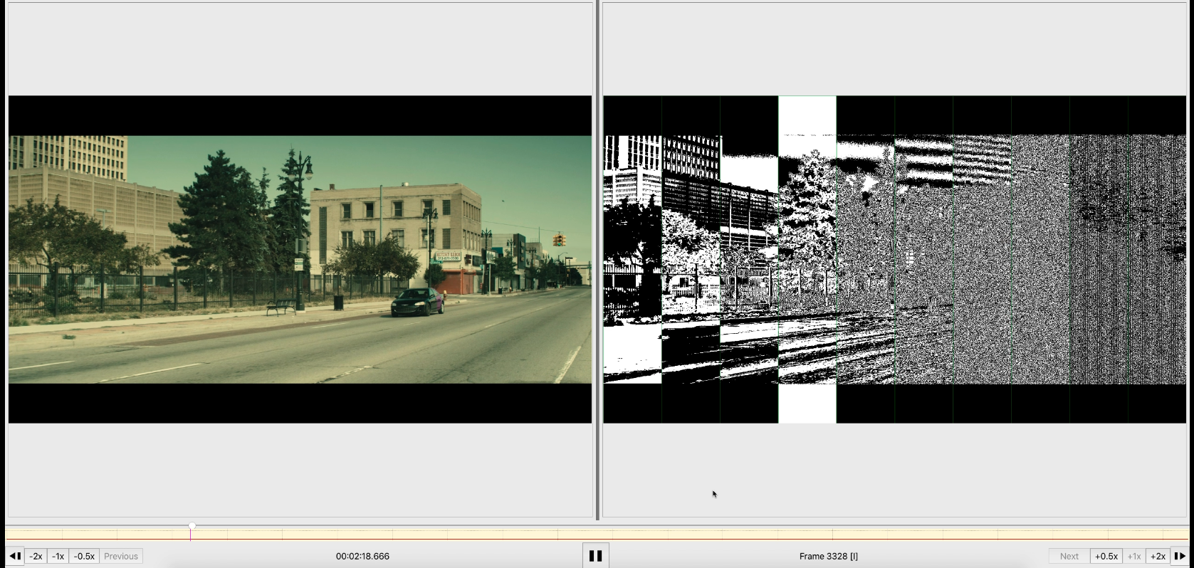

Slide 11
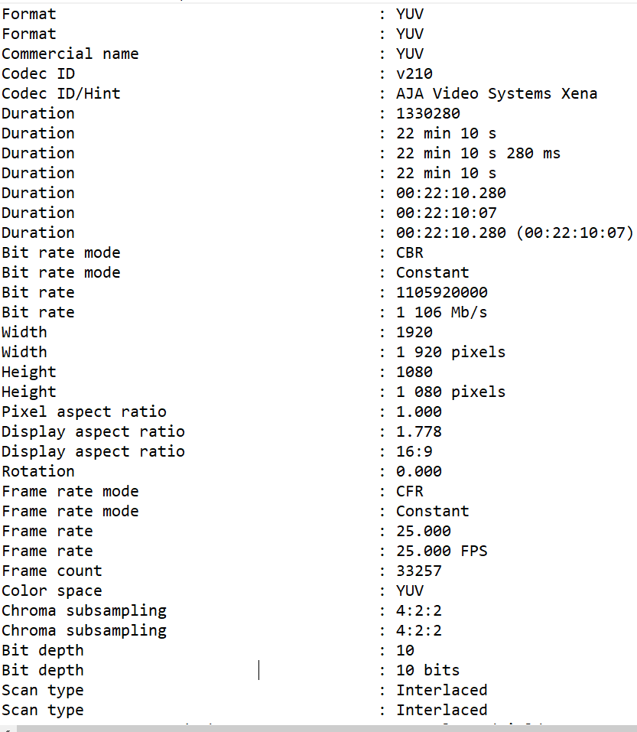
4. Bit plane - bit quality - deck variability variability
Decks supporting both native 8 bit and 10 bit analog and digital input with SDI outputs
Bit planes may show little to no differences in the higher bit planes -
When is it bit - padding?
When or how can you note bit quality
across decks?
Thanks to Eddy Colloton, @EddyColloton
Hirshhorn Museum and Sculpture Garden, Smithsonian
Thanks also to Kieran O’Leary, @kieranjol,
IFI Dublin

Slide 13
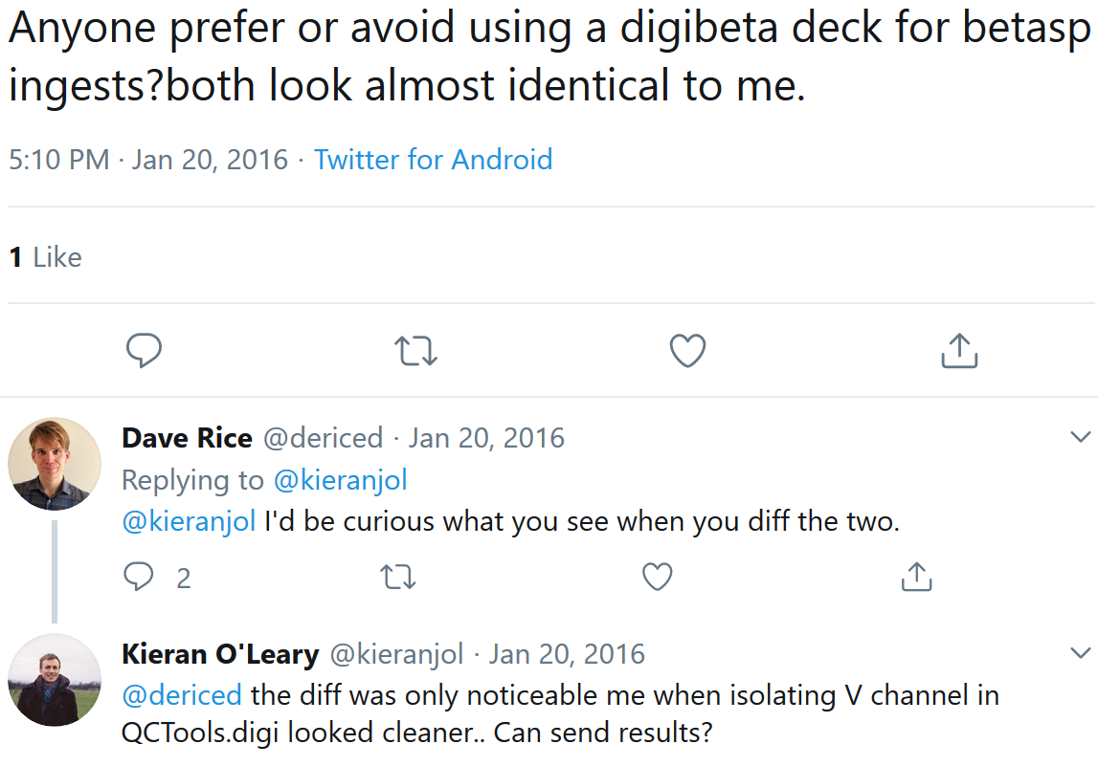

Slide 14
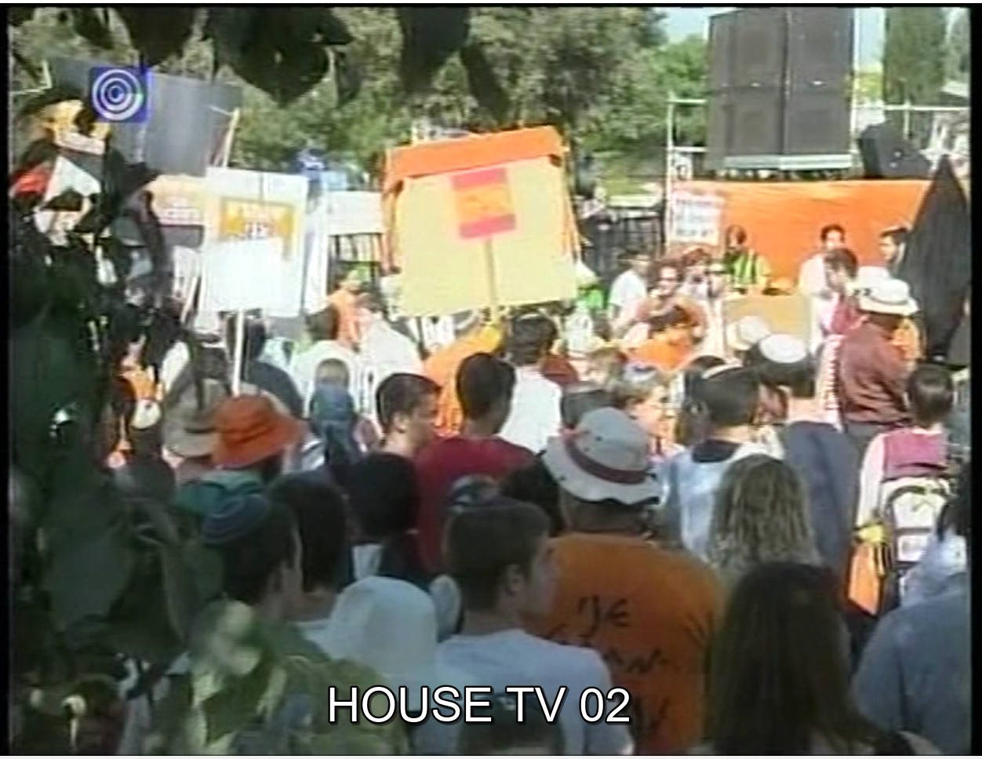

Slide 15
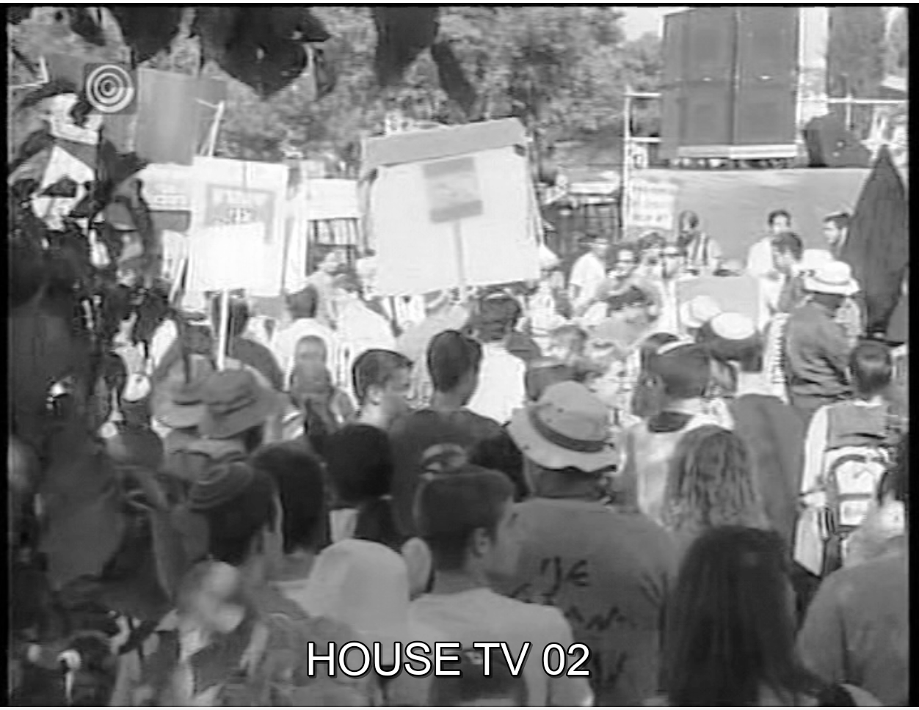
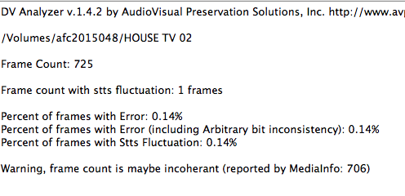
5. DV ...

Slide 16
For example, a file consisting of a QuickTime wrapper and a DV stream may have metadata indicating that the stream is to be displayed as 16:9 aspect ratio, while the metadata in the wrapper indicates a 4:30 ratio.
-excerpt from Dave Rice’s “Audiovisual Adherence,” Tate

Slide 17
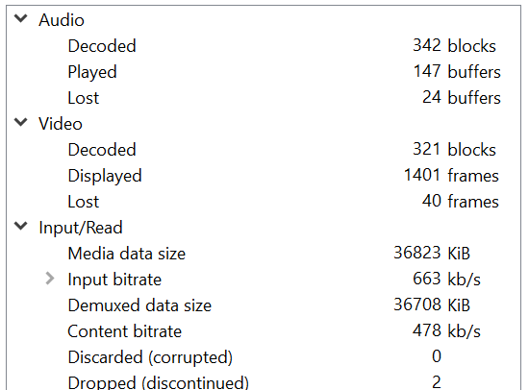
Single dv file captured can support
many contradictory significant qualities.
2005 era capture, probable Firewire transfer, QT wrapped.
Potentially other issues lurking?
Shiny new tools - DV Rescue!
Thanks to Annie Schweikert @aeschweik
Stanford Library, UC Berkeley Art Museum and Pacific Film Archive.
Thanks also to Dave Rice and Ashley Blewer

Slide 18
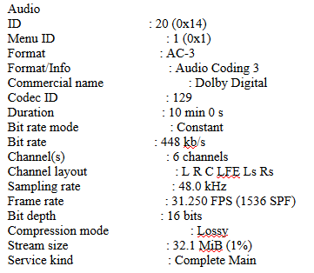
6. Dolby E proprietary encoding
Access copy:
Dolby E created for production and broadcast environments.
Encoded as data (not streams) in HDCam, bypasses HDCam stream limits
Data is unreadable and unrecognizable.
Access or exhibition copies from artist use proprietary lossy Dolby AC-3 (played sample noise)
Thanks to Shu-Wen Lin, Smithsonian American Art

Slide 19
Discussion
Yvonne Ng - WITNESS
Everyone else
(Thank you !)

